Slide 1



Presented by Xavier Inyangat
Tucson Restaurant Recommendation
Using Hybrid & Item-Based Collaborative Filtering Approach
15 February, 2024
1

Slide 2


Project Objectives
1
4
Business Problem
Methodology
2
5
Business Idea
Results
3
6
EDA
Insights
2

Slide 3

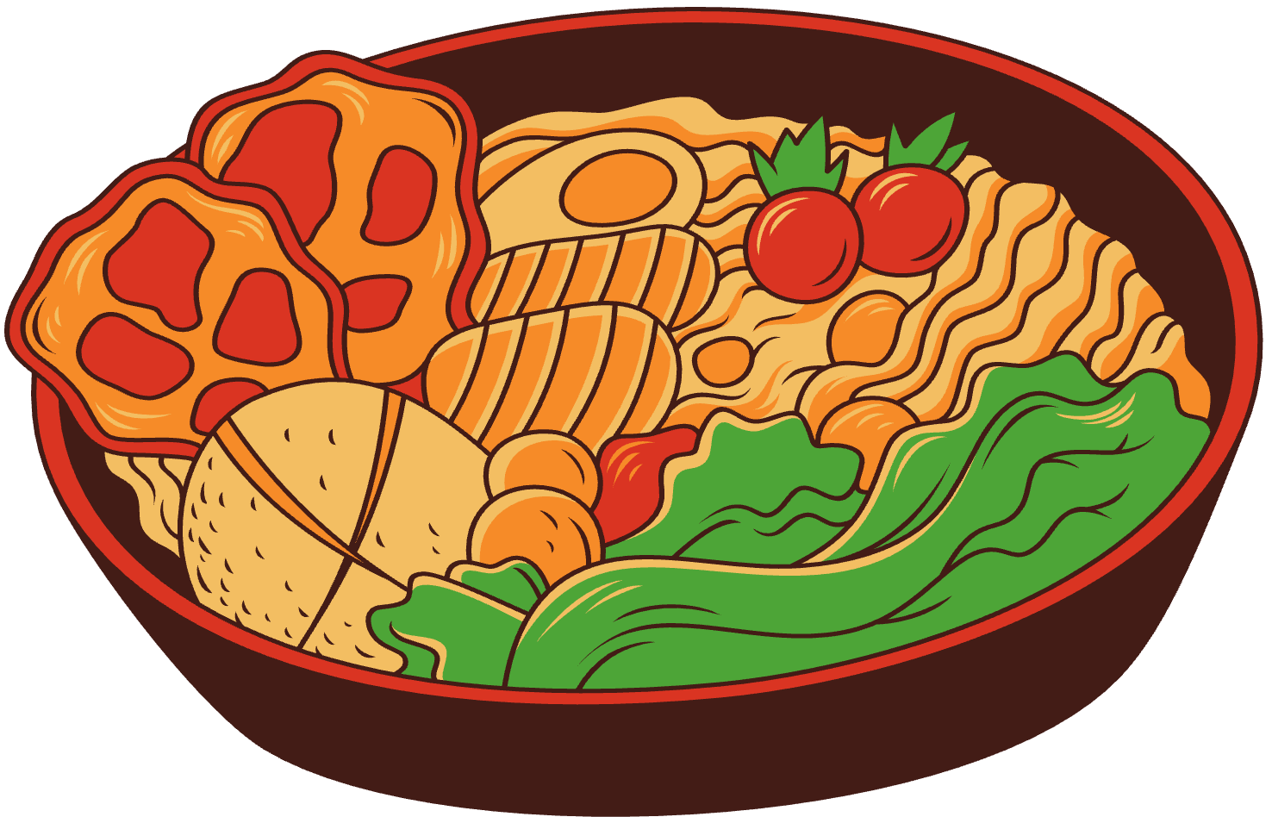


Introduction & Problem
Choosing where and what to eat can be daunting
With thousands of restaurants available, making the right choice can be overwhelming. Its a struggle finding places that match consumer preferences - ambiance, and dining expectations.
Traditional filters and reviews fall short.
A 4-star restaurant for one person may not suit another.
Many restaurants don’t prioritize what truly matters to each diner’s indivisual needs
With overwhelming choices, businesses miss out on their ideal customer base and consumers miss out on their ideal experiences
3

Slide 4

Business Idea
Our Solution: A data-driven recommendation system that personalizes restaurant suggestions based on business features and customer reviews.
Why Our Approach Works:
Understands customer sentiment & restaurant reputation instead of just relying on ratings.
Finds new, relevant restaurants even for cold-start cases.
Improves recommendation recall while maintaining high precision.
Customers receive highly personalized restaurant suggestions, no decision overload
Businesses connect with ideal customers, improving visibility and engagement.
4

Slide 5
Business Idea
Our Solution: A data-driven recommendation system that personalizes restaurant suggestions based on business features and customer reviews.
Example: “Find a highly rated restaurant with good ambience”
Chatbot would provide real-time recommendations enriched with insights from customer reviews.
Why Our Apporach Works:
Understands customer sentiment & restaurant reputation instead of just relying on ratings.
Finds new, relevant restaurants even for cold-start cases.
Improves recommendation recall while maintaining high precision.
Customers receive highly personalized restaurant suggestions, no decision overload
Businesses connect with ideal customers, improving visibility and engagement.
5

Slide 6





Exploratory Data Analysis
1641
201k
03
123
Open Rest’nts
Reviews
Avg. Rev’w/User
Avg. Rev’w/Rest’nt
Data Features
Rest’nt Name
Star Ratings
Review Text
Category
Location
user id

Slide 7
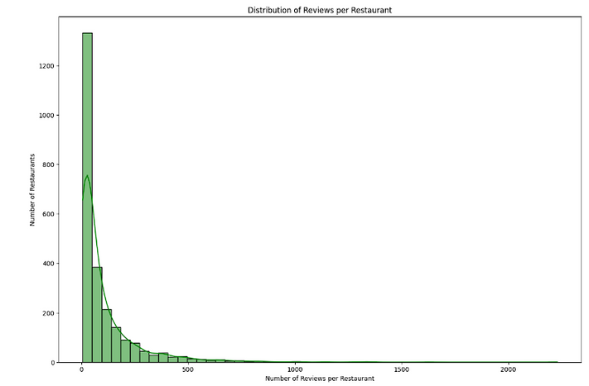
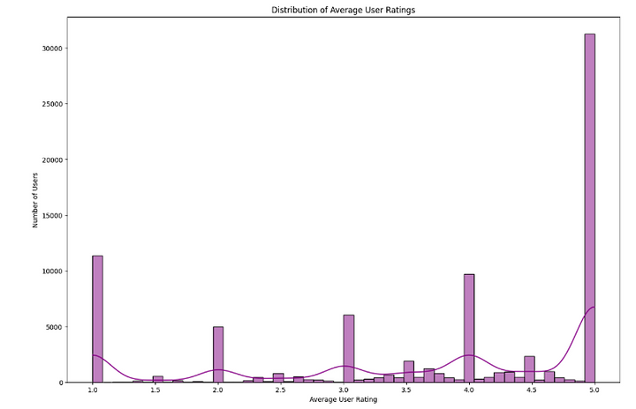
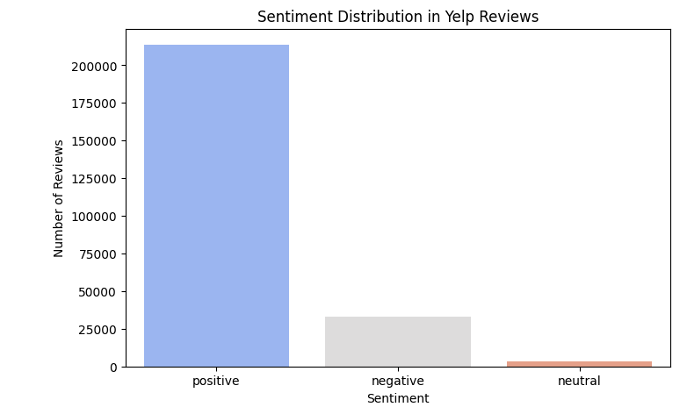



Further Exploratory Data Analysis
Distribution of Reviews per Restaurant
Distribution of Average User Ratings
Sentiment Distribution in Yelp Reviews
VADER (Valence Aware Dictionary and Sentiment Reasoner)
built for social media and short texts
good choice for Yelp reviews- a form
of social media reviews tailored for
business
Bias
small # of restaurant dominants a large # of reviews
Users are more inclined to leave polarizing reviews
7

Slide 8
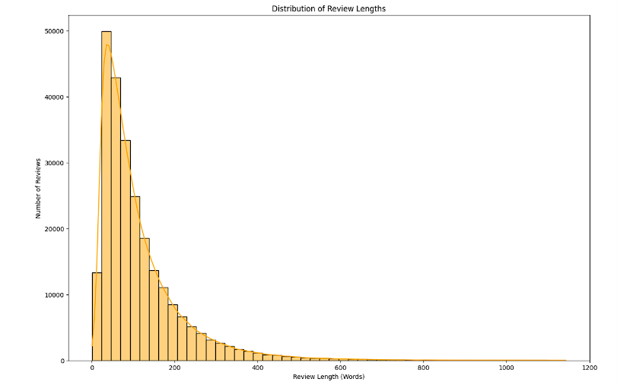
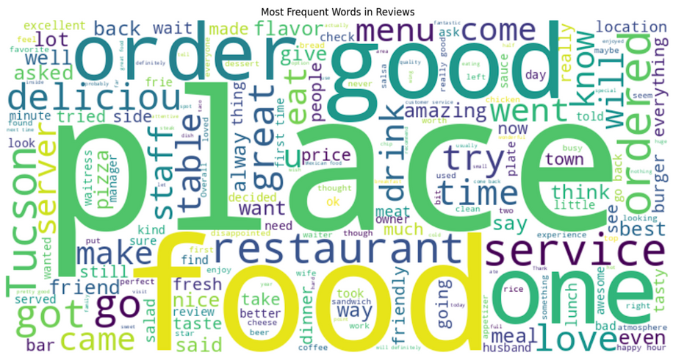
Further Exploratory Data Analysis
Distribution of Review Lengths
Avg Reviews: 50-150 words
Long Reviews: 500 words.
Variation in detailed feedbacks may impact NLP-based recommendations
Common words: “food,” “place,” and “order”
useful for sentiment analysis and context-aware recommendation
8

Slide 9
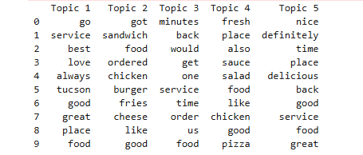
Further Exploratory Data Analysis
Topic Modeling
LDA topic modeling identified five key themes in Yelp reviews:
Customer Experience & Service Quality: Focus on service, satisfaction, and repeat visits.
Specific Food Items & Orders: Mentions of sandwiches, burgers, and fries dominate.
Wait Time & Order Process: Concerns about service efficiency and delays.
Freshness & Ingredients: Emphasis on food quality, freshness, and taste.
Overall Restaurant Recommendation: Positive feedback and repeat visit intentions.
9

Slide 10


Methodology 1: Item-based Colaborative Filtering
YOU LIKE just ONE RESTAURANT ?
Finds restaurants that are similar based on structured data.
Uses past customer interactions and ratings trends to measure similarity.
Similarity is computed using Cosine Similarity on numerical business features
Cosine Similarity Matrix
Vectorization
Computed Cosine Similarty from vector matrices
Generate top-n Recommendations
Normalized features, used TF-IDF
Feature Engineering
Evaluate model
Extracted Ratings, Reviews, categories
Precision, Recall, MAP, NDCG
10
WE KNOW 10 MORE YOU MAY LIKE

Slide 11
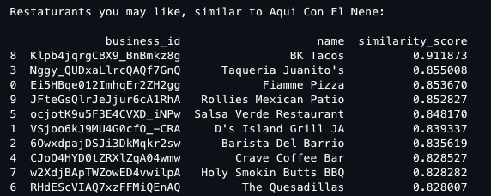


Methodology 1: Item-based Colaborative Filtering
Strengths
Highly accurate for restaurants with strong rating patterns.
Works without users, making it effective in sparse datasets.
Ensures recommendations are aligned with customer satisfaction trends.
Weaknesses
Does not work well for new restaurants with few reviews (cold start problem).
Might not capture a restaurant themes (e.g., ambiance, menu style).
11

Slide 12


Methodology 2: Hybrid Model (Colaborative + Content Based Filtering)
Combines two recommendation techniques:
1. Item-Based CF (70%) - Finds restaurants based on ratings, review count, and sentiment scores.
2. Content-Based Filtering (30%) - Uses restaurant descriptions & categories to recommend similar restaurants.
Feature Engineering
Extract business features & compute sentiment scores from reviews
Merging the Two Models
Weighted Sum =
Item-Based CF Similarity Matrix
Uses structured data to compute similarity.
(Item-Based CF x 0.7) + (Content Similarity x 0.3)
Content-Based Similarity Matrix:
Applies TF-IDF on restaurant descriptions to compute textual similarity.
12

Slide 13
Methodology: Key Differences
Aspect | Item-Based Collaborative Filtering (CF) | Content-Based Filtering (CBF)
Similarity Based On | Ratings, sentiment, review count, TF-IDF on categories | Restaurant descriptions, menus, and customer reviews
How Similarity is Computed | Cosine Similarity on structured numeric business data | Cosine Similarity on TF-IDF text embeddings
What It Captures | Customer satisfaction trends (good ratings, high sentiment) | Thematic restaurant features (cuisine, ambiance, service style)
Works Best For | Highly rated, well-reviewed restaurants | New or unique restaurants without many ratings
Main Weekness | Struggles with new restaurants (Cold Start Problem) | Poor recall, may recommend textually similar but low rated restaurants
13

Slide 14

Results
Model | Precision@10 | Recall@10 | MAP@10 | NDCG@10
Item-Based CF | 0.900 | 0.0314 | 0.7071 | 0.8329
HyBrid (CF + Content Based) | 0.500 | 0.0174 | 0.2222 | 0.5663
Key Takeaways:
Item-Based CF outperforms all other models in terms of precision and ranking quality.
Hybrid Model improves recall slightly but sacrifices precision due to content-based noise.
Recall is low for both models, meaning additional improvements may be needed.
Challenges & Areas of Improvement:
Cold Start Problem = Introduce popularity based fall back recommendations.
Over Reliance on Certain Features (Category Bias) = Adjust feature weighting dymically based on restaurant popularity.
Limited Recall (Only few relevant items found per query) = Increase content similarity weighting for restaurants with fewer ratings.
14

Slide 15

Insights
Item-Based Collaborative Filtering is the most effective approach, achieving high precision (90%) and strong ranking quality.
The Hybrid Model improves recall slightly but sacrifices precision.
Future improvements could include incorporating a popularity-based fallback system, better feature balancing, and personalized recommendations for different user needs.”
Final Recommendation: Deploy Item-Based CF for best results.
Hybrid Model can be improved by fine-tuning weighting.
Future Work: Consider using deep learning embeddings (BERT) for improved text-based similarity.
15

Slide 16
Thank you
16

